Slide 1
Faculty Development Program (FDP) Day 4 - Assessments, Grading & Feedback with AI

Slide 2
Session 16: AI in Assessments: Types & Tools

Slide 3
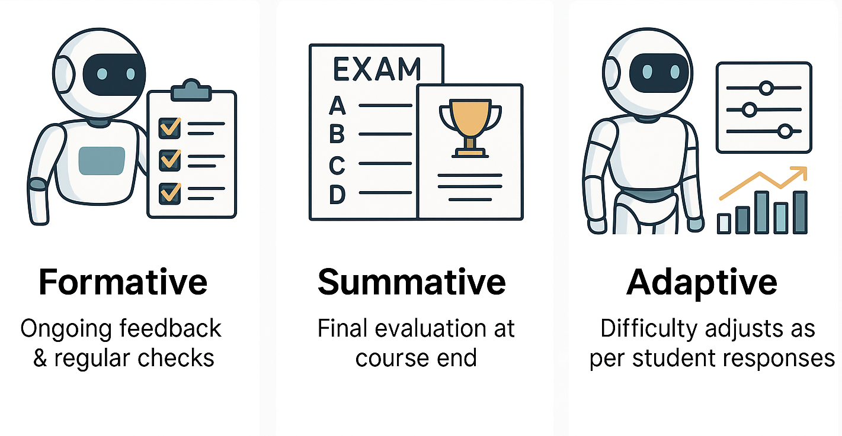
Types: Formative, summative, adaptive assessments
Formative Assessments
Continuous checks during learning
Provides feedback to improve progress
Summative Assessments
Conducted at the end of unit/course
Measures final learning outcomes
Adaptive Assessments
Adjusts difficulty in real-time
Personalized evaluation for each learner

Slide 4
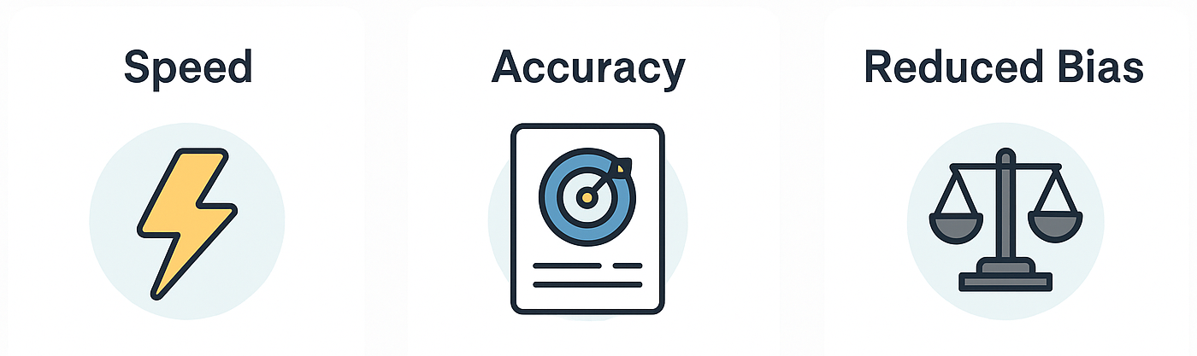
Benefits of AI vs manual evaluation: speed, accuracy, reduced bias
Speed
AI grades instantly
Saves teacher’s time
Accuracy
Minimizes human error
Consistent evaluation
Reduced Bias
Neutral grading
Fair outcomes for all students

Slide 5
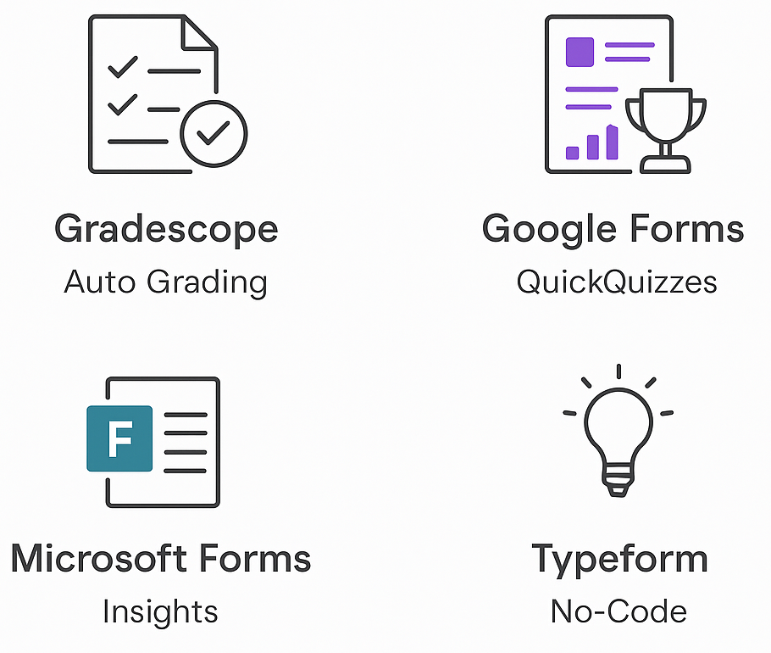
Examples: Gradescope, Google Forms Quiz Mode, Microsoft Forms, Type form (no-code quiz creation)
Gradescope
Automates exam/assignment grading
Saves teacher effort
Google Forms Quiz Mode
Quick MCQ creation
Auto-grading & instant feedback
Microsoft Forms
Analytics dashboard
Real-time quiz insights
Type form
Engaging quizzes & surveys
No-code, easy to use

Slide 6
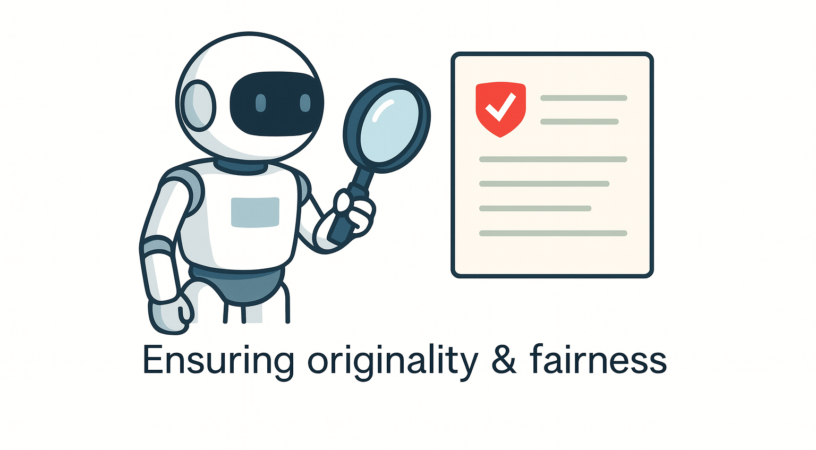
AI in plagiarism detection (Turnitin Draft Coach)

Slide 7


Slide 8



Slide 9
Session 16: Quiz
Q.1 Which type of assessment adjusts difficulty in real-time based on student responses? a) Formative b) Summative c) Adaptive
Answer: c) Adaptive

Slide 10
Session 16: Quiz
Q.2 Which tool is mainly used for plagiarism detection? a) Gradescope b) Google Forms Quiz Mode c) Turnitin Draft Coach d) Microsoft Forms
Answer: c) Turnitin Draft Coach

Slide 11
Session 16: Quiz
Q.3 What is one major benefit of AI in assessments compared to manual evaluation? a) More errors in grading b) Faster grading and reduced bias c) Requires more time from teachers d) Completely replaces teachers
Answer: b) Faster grading and reduced bias

Slide 12
Session 16: Quiz
Q.4 Gradescope is best known for: a) Creating presentations b) Automated grading of exams/assignments c) Conducting online lectures d) Video-based learning
Answer: b) Automated grading of exams/assignments

Slide 13
Session 16: Quiz
Q.5 AI-based plagiarism detection tools help ensure academic honesty by highlighting copied content. (True/False)
Answer: True

Slide 14
Session 17: Quiz Generator GPTs

Slide 15
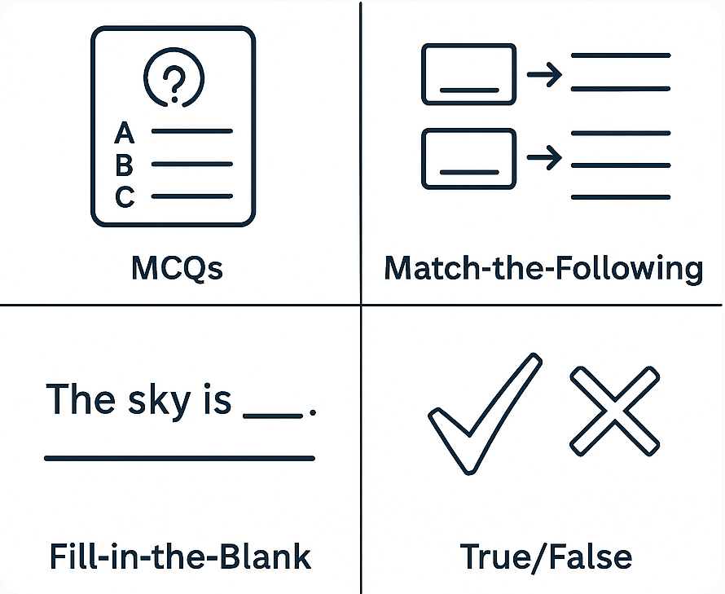
Using GPT for MCQs, match-the-following, fill-in-the-blank, and true/false

Slide 16
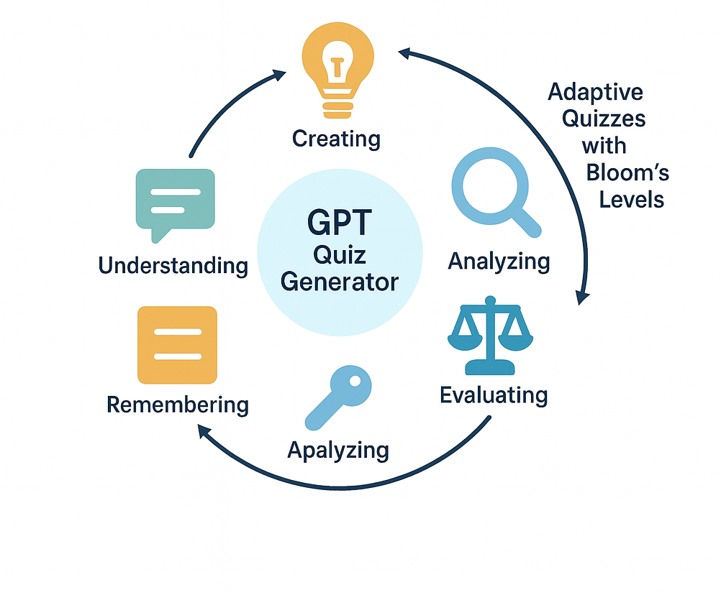
Cognitive level mapping with Bloom’s taxonomy

Slide 19
Session 17: Quiz
Q.1 Which quiz format is best for testing factual recall quickly? a) MCQs b) Match-the-Following c) Fill-in-the-Blank d) True/False
Answer: d) True/False

Slide 20
Session 17: Quiz
Q.2 GPT can generate quizzes aligned with which framework of cognitive levels? a) Maslow’s Hierarchy b) Bloom’s Taxonomy c) Kolb’s Cycle d) Kirkpatrick Model
Answer: b) Bloom’s Taxonomy

Slide 21
Session 17: Quiz
Q.3 Fill in the blank: GPT can generate ________ type questions to test relationships between concepts.
Answer: Match-the-Following

Slide 22
Session 17: Quiz
Q.4 Which of the following tools can be used to import GPT-generated quizzes directly into classrooms? a) Photoshop b) Quizizz c) Excel d) Canva
Answer: b) Quizizz

Slide 23
Session 17: Quiz
Q.5 GPT can automatically tag each question to a Bloom’s taxonomy level. (True/False)
Answer: True

Slide 24
Session 18: Rubric & Feedback GPTs

Slide 25
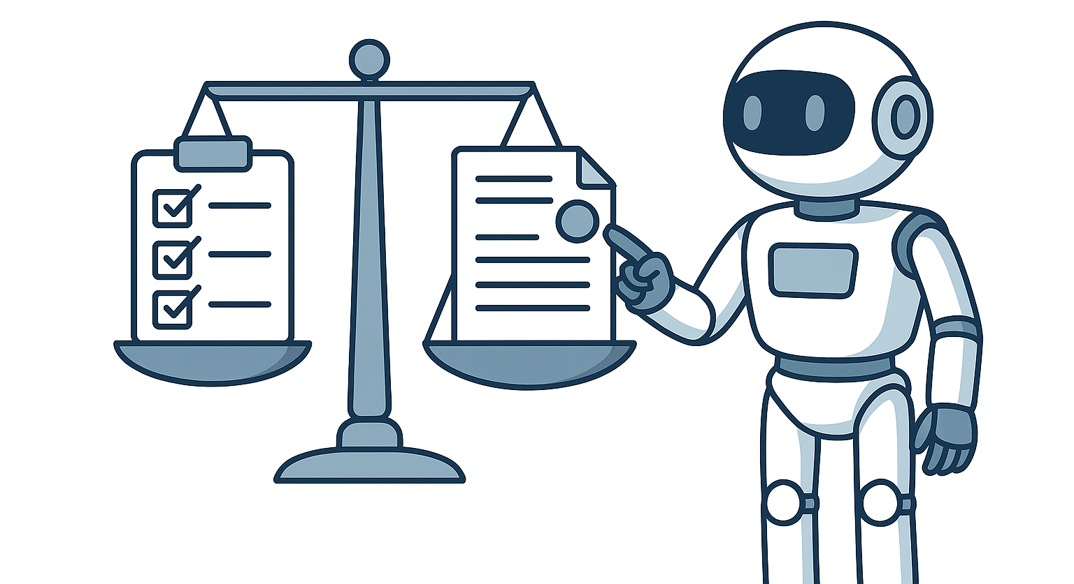
Importance of grading rubrics for fair evaluation
Rubrics give clear criteria for marking student work.
Ensure fairness & consistency in evaluation across all learners.
Help students understand expectations before attempting tasks.
Reduce subjectivity by focusing on defined performance levels.
Provide structured feedback that guides improvement.

Slide 26
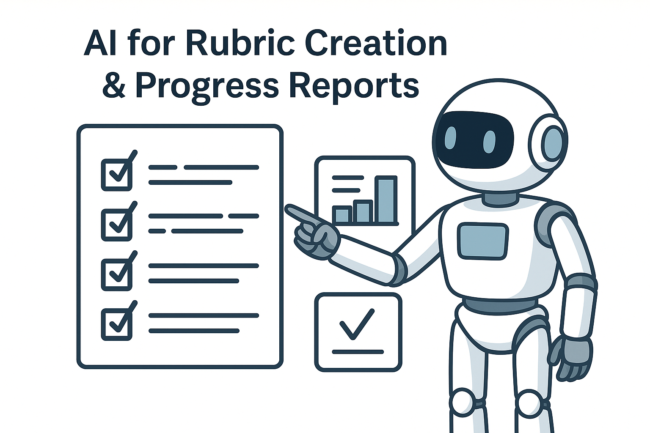
AI for rubric creation and progress reports.
GPT auto-generates rubrics with criteria & performance levels.
Saves teacher time by reducing manual rubric design.
Aligns rubrics with learning outcomes & Bloom’s levels.
Reports give data-driven insights into student strengths & gaps.

Slide 29
Session 18: Quiz
Q.1 What is the main purpose of using grading rubrics? a) To make evaluation random b) To ensure fairness and consistency c) To reduce teacher workload completely d) To replace student feedback
Answer: b) To ensure fairness and consistency

Slide 30
Session 18: Quiz
Q.2 Which AI tool can assist in creating rubrics and progress reports? a) Photoshop b) CoRubric c) Canva d) PowerPoint
Answer: b) CoRubric

Slide 31
Session 18: Quiz
Q.3 Rubrics help students understand expectations before attempting tasks. (True/False)
Answer: True

Slide 32
Session 18: Quiz
Q.4 GPT can help generate rubrics that align with: a) Learning outcomes and Bloom’s taxonomy b) Teacher’s personal preference only c) Random grading criteria d) Student popularity
Answer: a) Learning outcomes and Bloom’s taxonomy

Slide 33
Session 18: Quiz
Q.5 Which of the following is a benefit of AI-generated progress reports? a) Randomized student scores b) Data-driven insights into strengths and gaps c) Eliminates the need for teachers d) Reduces transparency in grading
Answer: b) Data-driven insights into strengths and gaps

Slide 34
Session 19: Role-play: AI as Student Evaluator

Slide 35
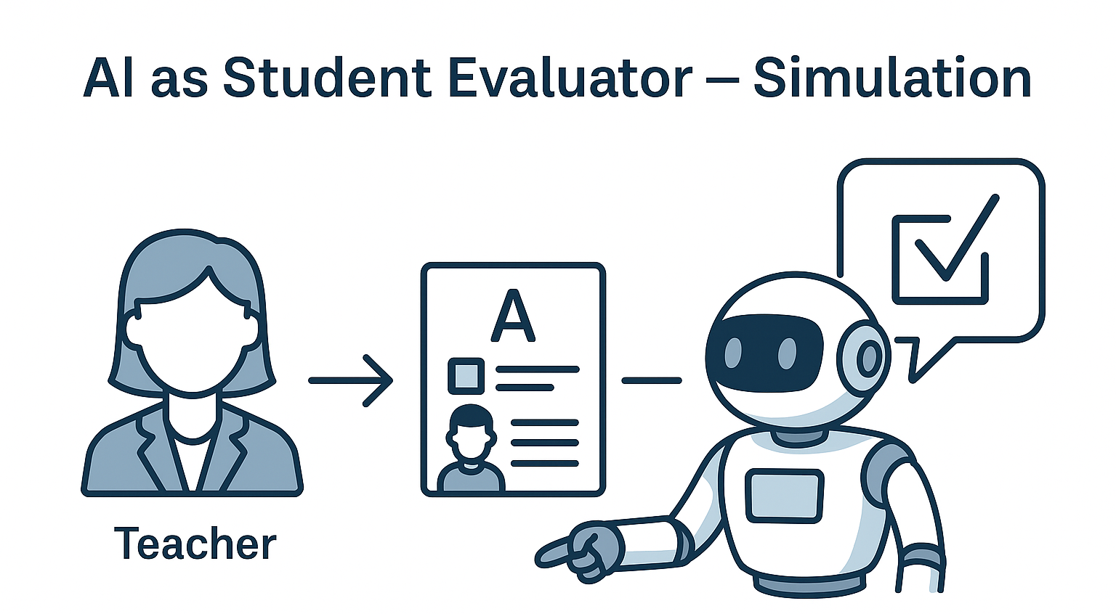
Simulation: Teacher assigns work → GPT evaluates and provides feedback.
Teacher uploads assignment or quiz answers.
GPT evaluates instantly using predefined rubrics.
Provides clear, structured feedback with strengths & improvements.
Saves time and ensures timely response for students.
Mimics real classroom workflow where AI acts as assistant.

Slide 36
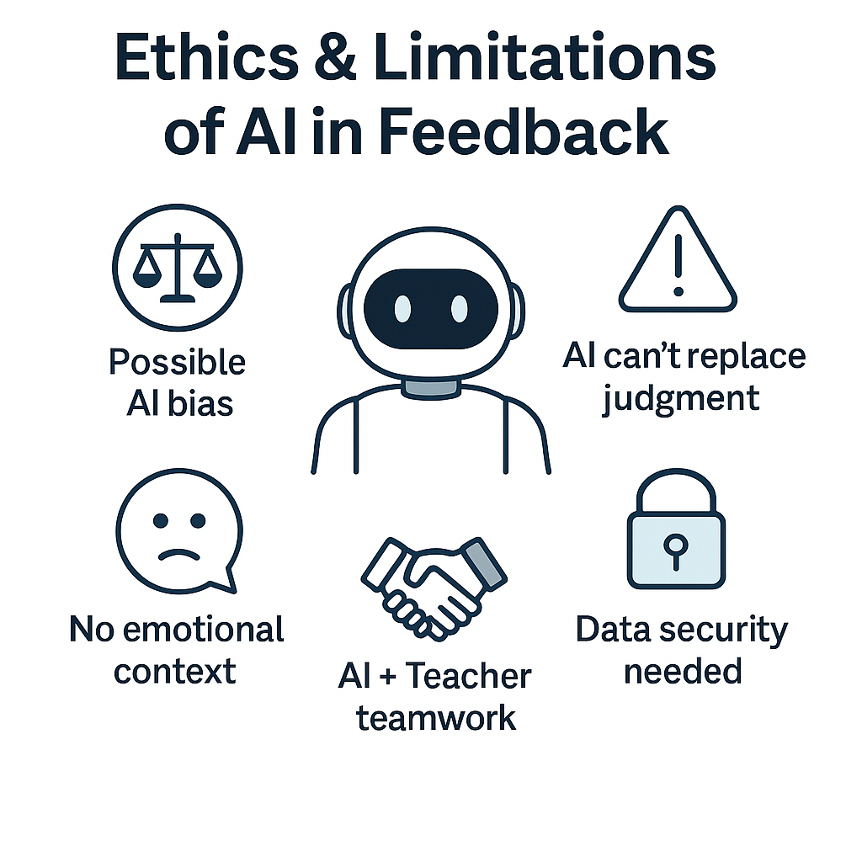
Ethics and limitations of AI in feedback.
Bias Risk - AI feedback may unintentionally reflect data biases.
Over-Reliance - Teachers and students should not depend on AI alone.
Lack of Human Touch - AI cannot fully understand emotions, tone, or context.
Privacy Concerns - Student data used by AI tools must be secured.
Complement, not Replace - AI should support teachers, not replace human judgment.

Slide 39
Session 19: Quiz
Q.1 In the simulation activity, what role does GPT play? a) Student submitting answers b) Teacher assigning work c) Evaluator providing feedback d) Peer reviewer
Answer: c) Evaluator providing feedback

Slide 40
Session 19: Quiz
Q.2 GPT can provide structured feedback highlighting both strengths and areas of improvement. (True/False)
Answer: True

Slide 41
Session 19: Quiz
Q.3 Which of the following is a major ethical concern with AI feedback? a) Faster grading b) Data privacy c) Clear rubrics d) Timely responses
Answer: b) Data privacy

Slide 42
Session 19: Quiz
Q.4 Fill in the blank: AI feedback may unintentionally reflect ________.
Answer: Bias

Slide 43
Session 19: Quiz
Q.5 What should be the role of AI in feedback according to ethical use? a) Replace teachers fully b) Support and complement teachers c) Focus only on grades d) Ignore student emotions
Answer: b) Support and complement teachers

Slide 44
Session 20: Assessment Redesign Task

Slide 45
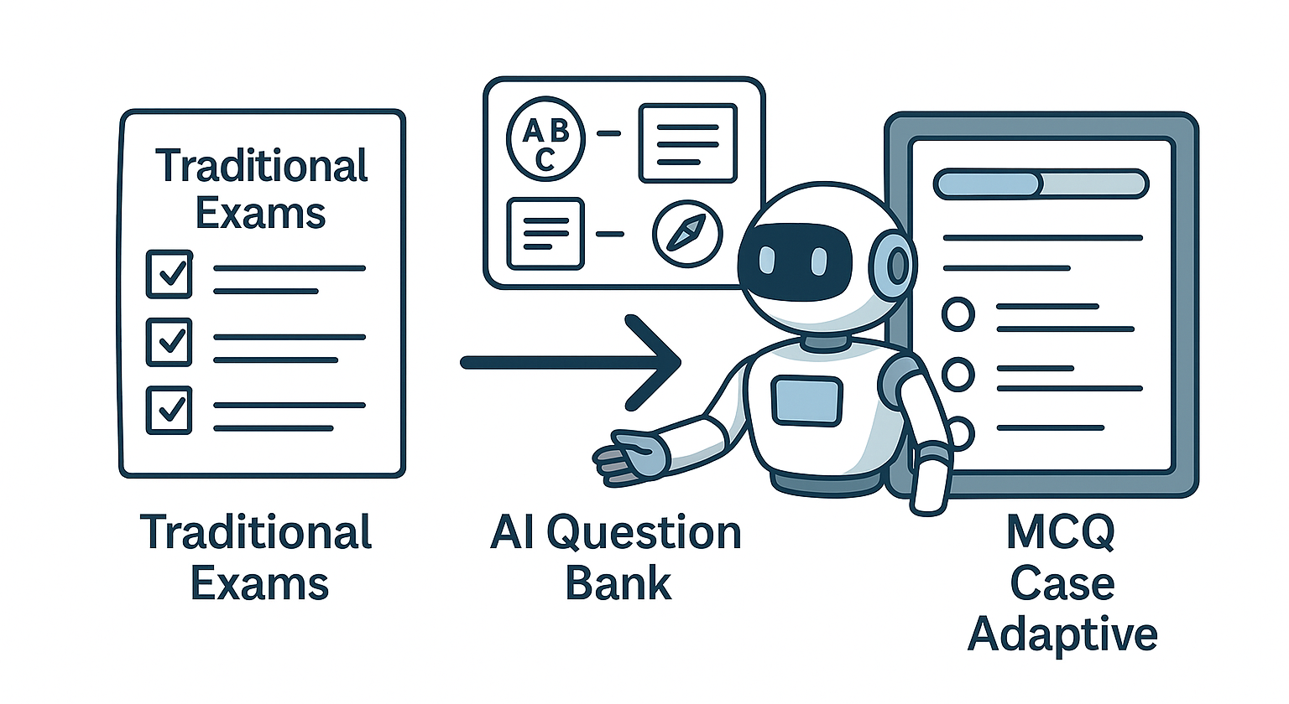
Redesigning Mid-Sem exams using AI

Slide 46
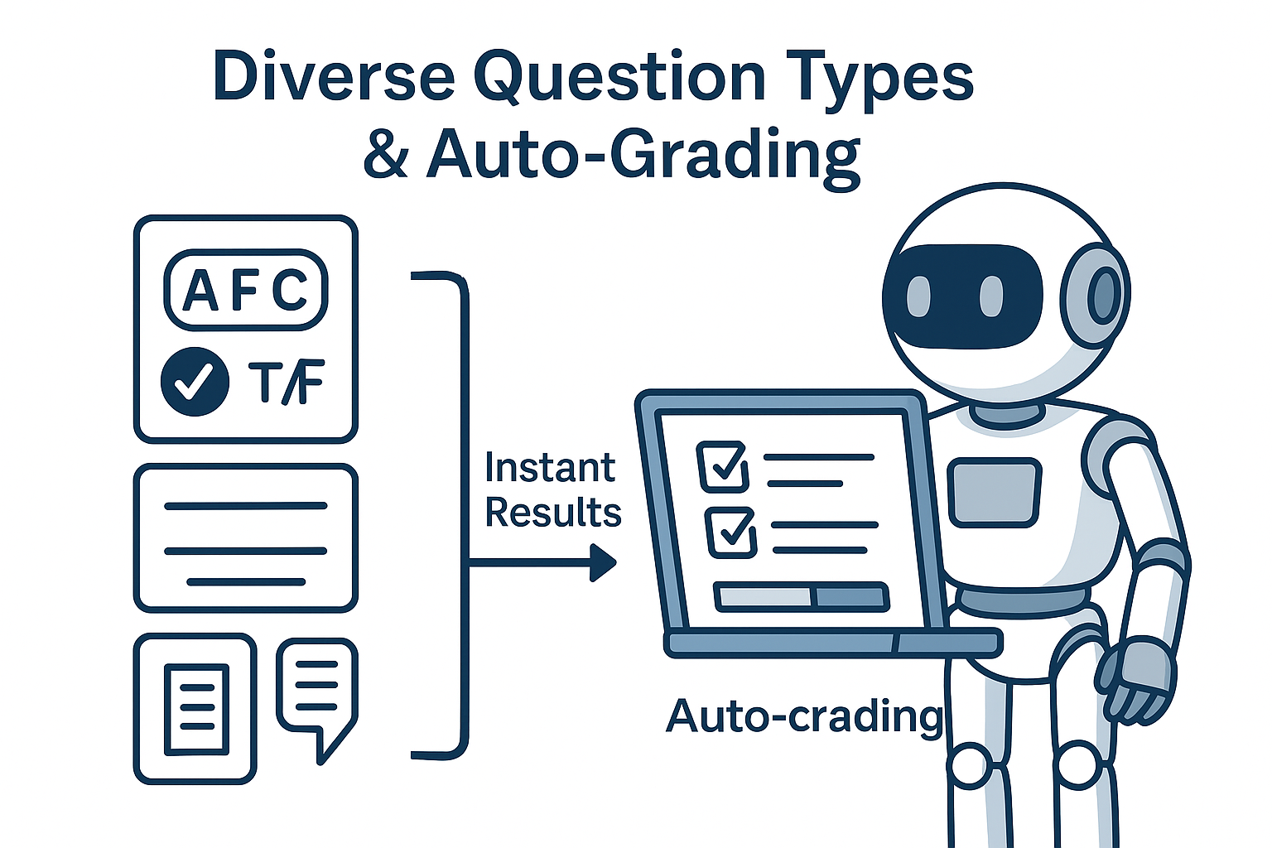
Incorporating diverse question types & auto-grading

Slide 47
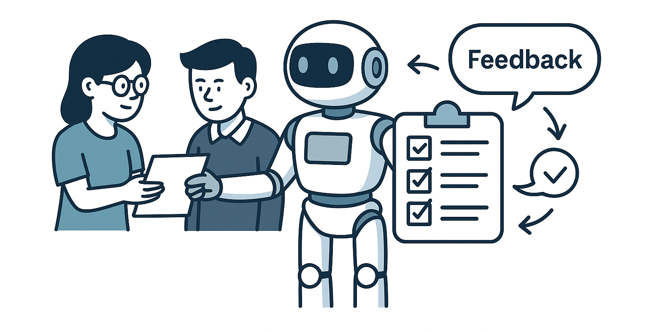
Peer review with AI-generated rubrics

Slide 50
Session 20: Quiz
Q.1 Which of the following is a key benefit of redesigning exams with AI? a) Focus only on rote learning b) Generating diverse and adaptive questions c) Eliminating student participation d) Limiting question formats
Answer: b) Generating diverse and adaptive questions

Slide 51
Session 20: Quiz
Q.2 AI can support both objective (MCQs, True/False) and subjective (essays, long answers) question types. (True/False)
Answer: True

Slide 52
Session 20: Quiz
Q.3 Which tool is commonly used for auto-grading of objective questions? a) Photoshop b) Google Forms c) Canva d) Excel
Answer: b) Google Forms

Slide 53
Session 20: Quiz
Q.4 Fill in the blank: Peer review becomes more fair and unbiased when ________ are generated by AI.
Answer: Rubrics

Slide 54
Session 20: Quiz
Q.5 What is the role of AI in peer review with rubrics? a) Replace students in reviewing b) Provide clear criteria for evaluation c) Make grading random d) Remove collaboration
Answer: b) Provide clear criteria for evaluation

Slide 55
Mini Project: Assessment Redesign with AI
Task: Redesign an assessment using Quizizz AI.
Use Quizizz AI to generate a complete quiz (MCQs, True/False, Fill-in-the-Blank, etc.).
Share the quiz with participants for live/play mode.
Leverage auto-grading instant results and scoring.
Analyze the leader board to see top performers and participation trends.
Deliverables:
Quizizz AI generated quiz link.
Leader board / result summary from Quizizz.

